Slide 1
SQLDeveloper, LowCode and APEX
Martin B. Nielsen, MBNDATA
DOUG

Slide 2

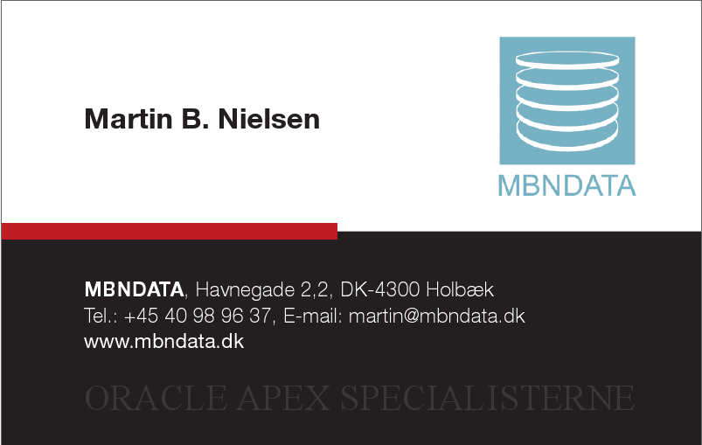
Profile

Slide 3
How to lowCode
Generate as much as possible
Use the tools which can help you generate your application artifacts.
Do NOT repeat your work (type once, use many times)
The less coding, the less bugs :-)
Encourage keeping documentation up to date, by making it a “living thing”.

Slide 4

Application Artifacts
Developers
Application
Documentation
Project Plan
Database

Slide 5
lowCode Landscape

Slide 6
lowCode using SQLDeveloper
Create process model
ER model -> Relational model
Resolve Many-to-Many relations
Generate primary keys
Generate constraints
Transformations
Index on foreign keys
RDBMS comments
Generating sequences
Generating triggers for PK
Generating triggers for auditing
…
Relational model -> DDL

Slide 7
SQLDeveloper Modelling
ER Model
Relational Model
DDL

Slide 8
SQLDeveloper Transformations

Slide 9
SQLDeveloper Process Model
Composite processes

Slide 10
SQLDeveloper Modeller
Demo

Slide 11
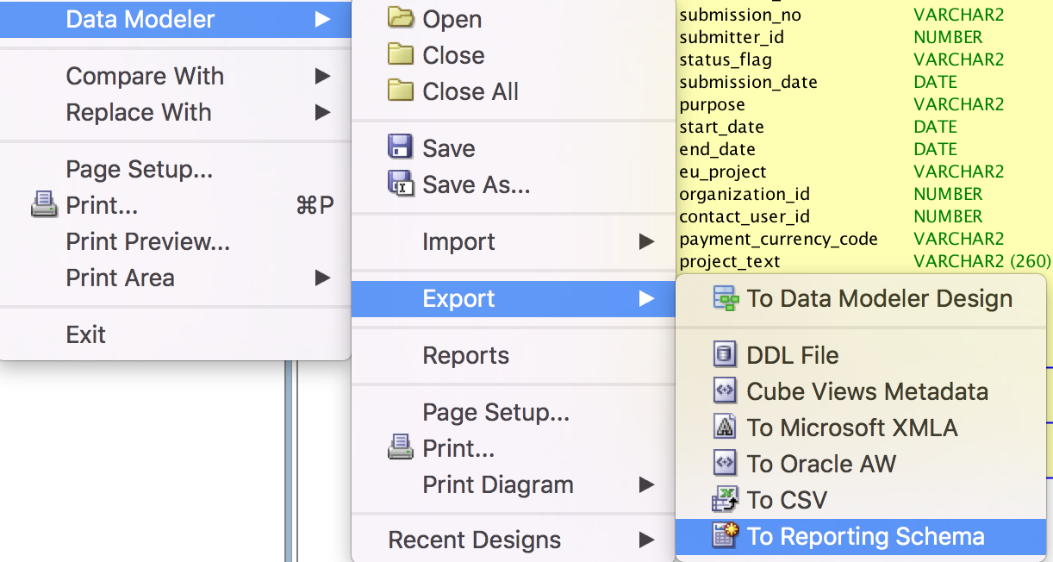
SQLDeveloper Reporting Scheme
Create the reporting scheme once
Export to the reporting scheme when the model changes

Slide 12
SQLDeveloper Reporting Scheme
Reporting Schema

Slide 13
Using the Reporting Scheme
Reporting Scheme
Reporting Schema | APEX
Domains | List of values
Process Model | Menu, Features, Developer assistance, Help Text
Datamodel | User interface defaults, Help Text

Slide 14
Reporting Scheme
Demo

Slide 15
lowCode Landscape
APEX 5 Packaged application for generating DDL
APEX 5.2 feature for generating applications

Slide 16
Quick SQL
Demo

Slide 17
APEX Blueprint
Demo

Slide 18
How do I start lowCoding ?
Download SQL Developer
Download examples from Github
Download database VM or use apex.oracle.com

Slide 19
Questions

